Slide 1

Airbnb Market Analysis & Real Estate Sales Analysis
Team Members
Vinod Kumar Murugan
Lokeshana Raj Sureshbabu Renukadevi
Anuradha Tarafder

Slide 2
CONTENTS
Outline
Approach
IDEF Models
Forms
Visualization
Scope

Slide 3
Outline
Overview :
Airbnb, Inc. is an American company operating an online marketplace for short- and long-term homestays and experiences. The company acts as a broker and charges a commission from each booking. The company was founded in 2008 by Brian Chesky, Nathan Blecharczyk, and Joe Gebbia.
DATASET: This is publicly available in Kaggle with the past years trend from 2019 consisting of 8 data tables of 4 zipcodes from California.
Amenities
Geolocation
Market_Analysis
Market_Analysis_2019
Sales_properties_zipcode_92252
Sales_properties_zipcode_92284
Sales_properties_zipcode_92314
Sales_properties_zipcode_92315

Slide 4
APPROACH
PROJECT:
1. Data Cleaning – The data is cleaned through excel.
2. Creation of IDEF MODELS –
IDEF0
IDEF1X
3. Creation of FORMS –
Execution of the forms using queries and macros in MS Access.
4. Data Visualization –
Used Power BI to create visual dashboards to perform data analysis

Slide 5
IDEF MODEL
IDEF (Integration Definition for Function Modeling) is a standardized methodology used to model and analyze complex systems. It employs clear and structured techniques to represent functions, data, and interactions within an organization. IDEF models improve communication and understanding, making them valuable for system analysis, design, and enhancement across diverse industries.

Slide 6
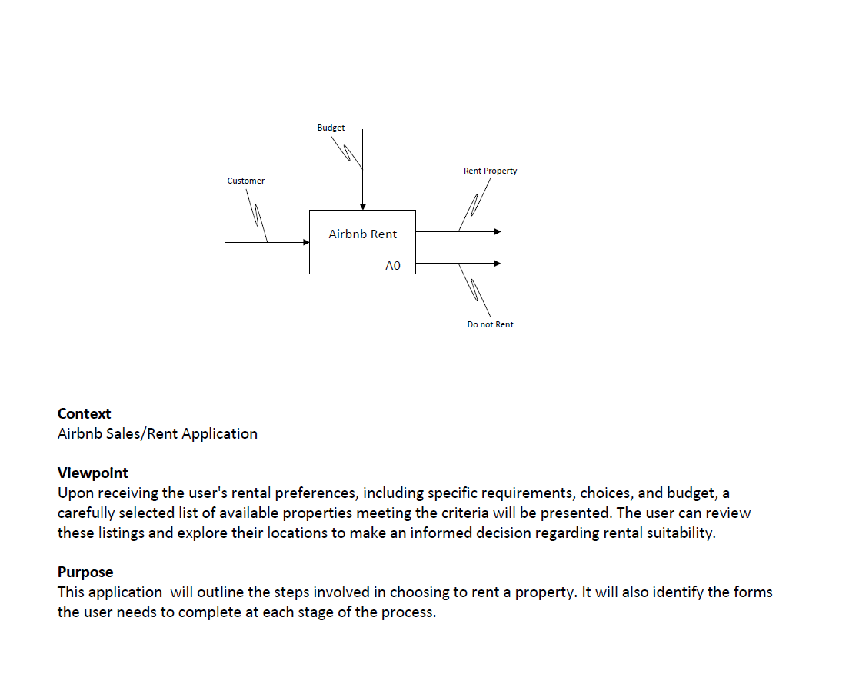
Cont.. IDEF0 MODEL

Slide 7
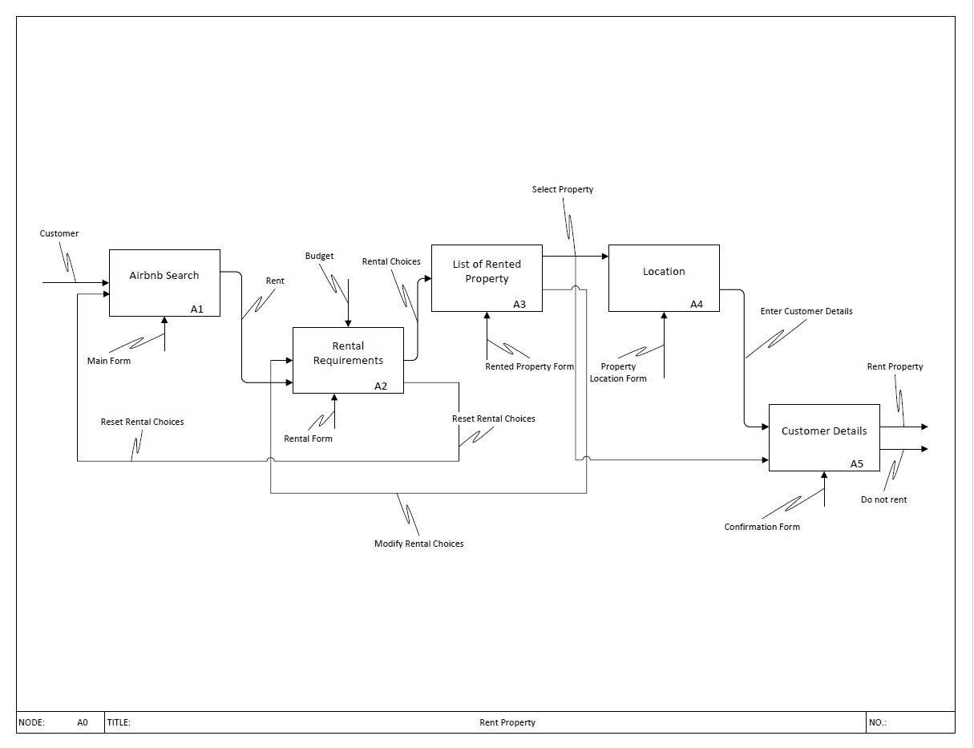

Slide 8
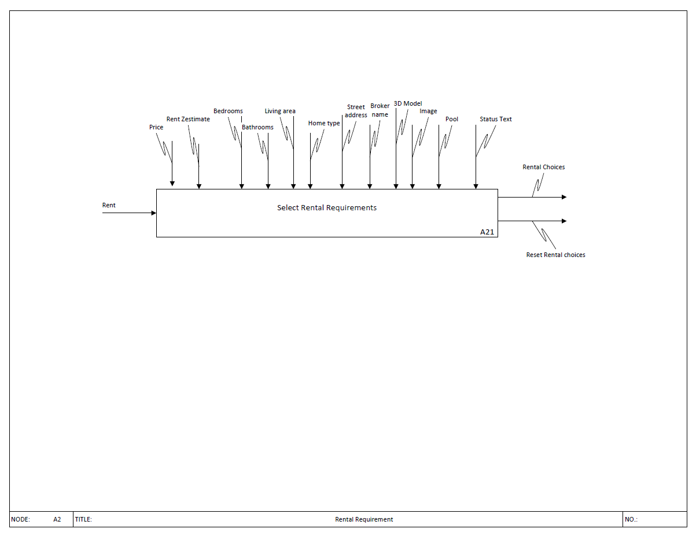

Slide 9
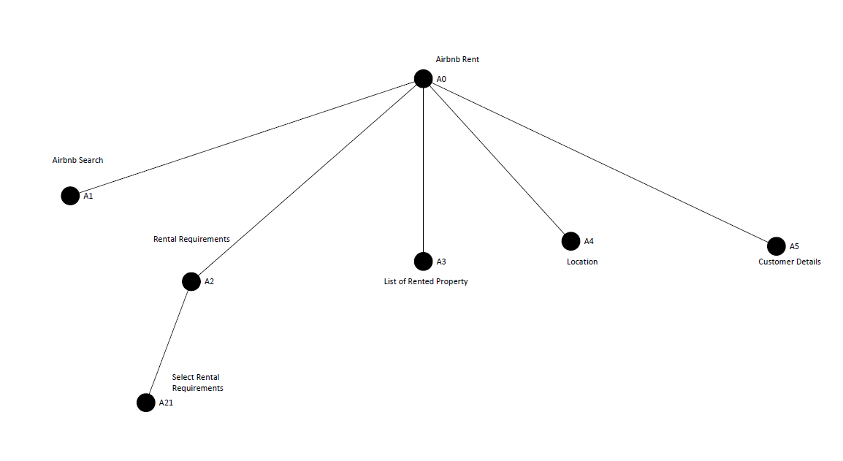
TREE NODE

Slide 10
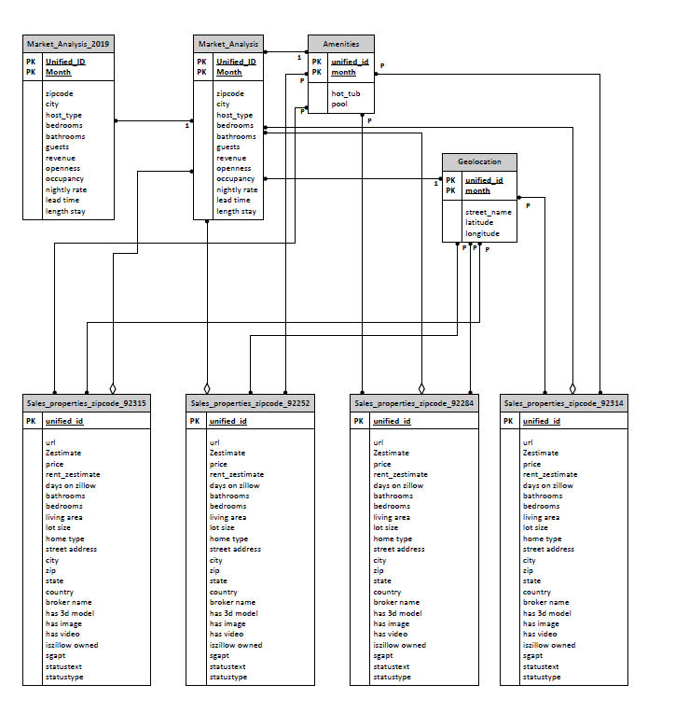
IDEF1X Model

Slide 11
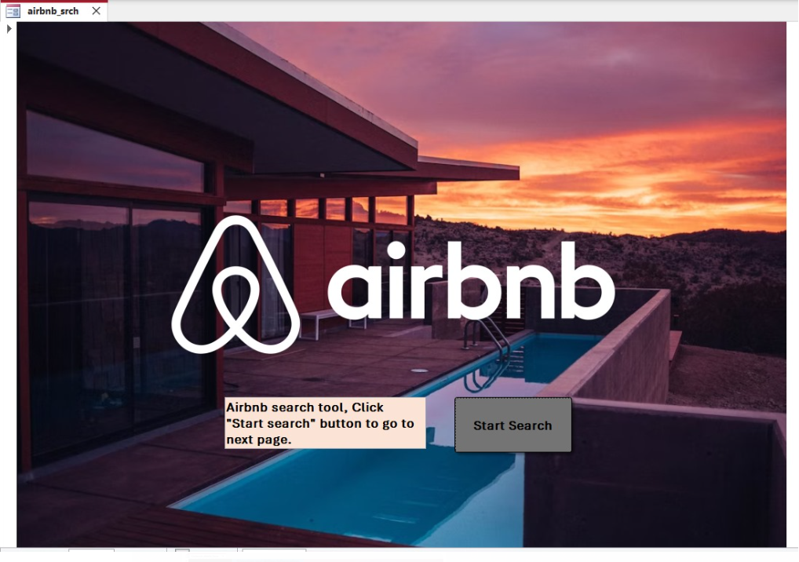
FORMS
1. Airbnb Search --

Slide 12
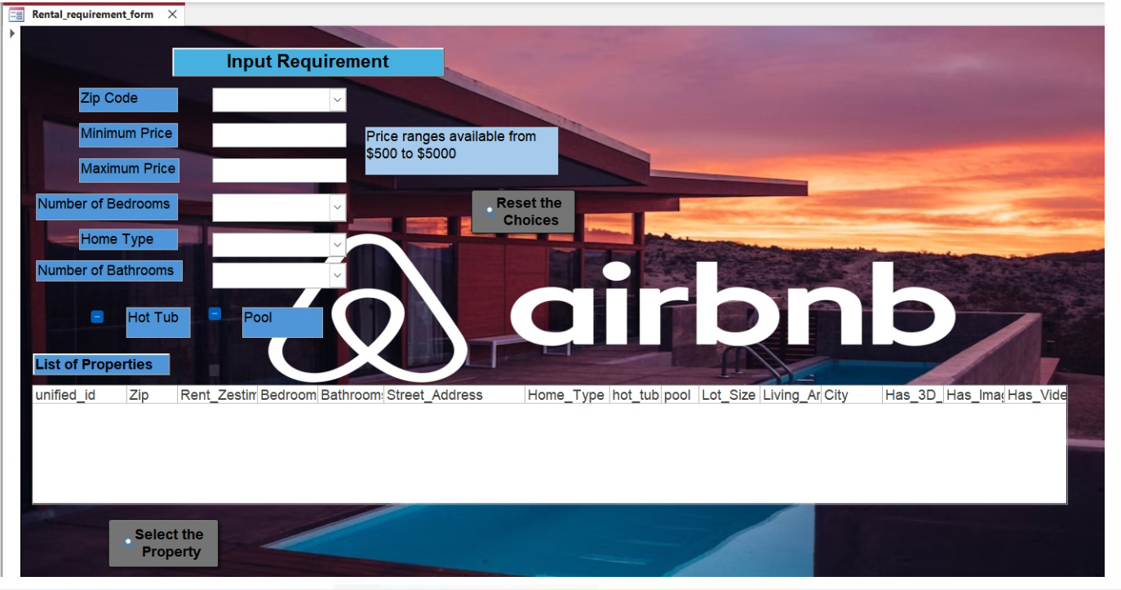
2. Rental Requirement Form

Slide 13
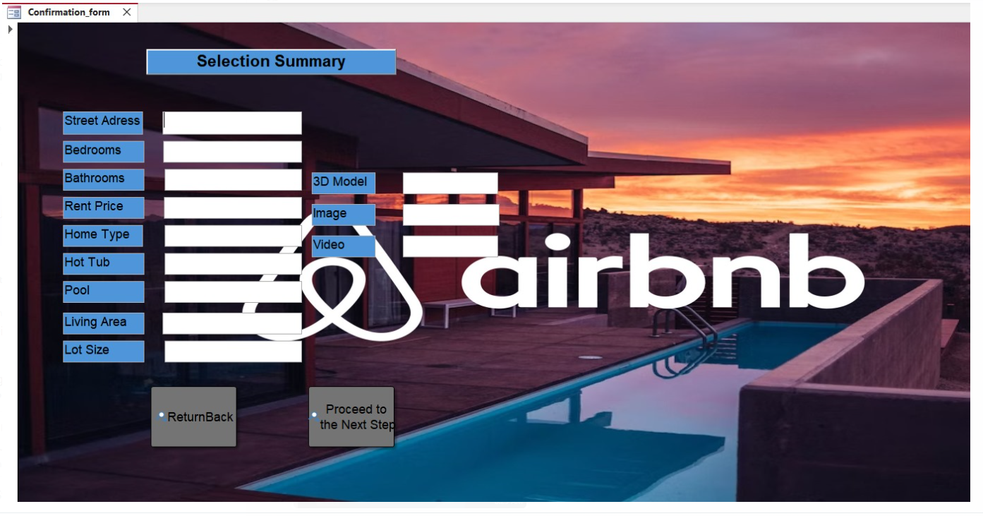
3. Confirmation Form

Slide 14
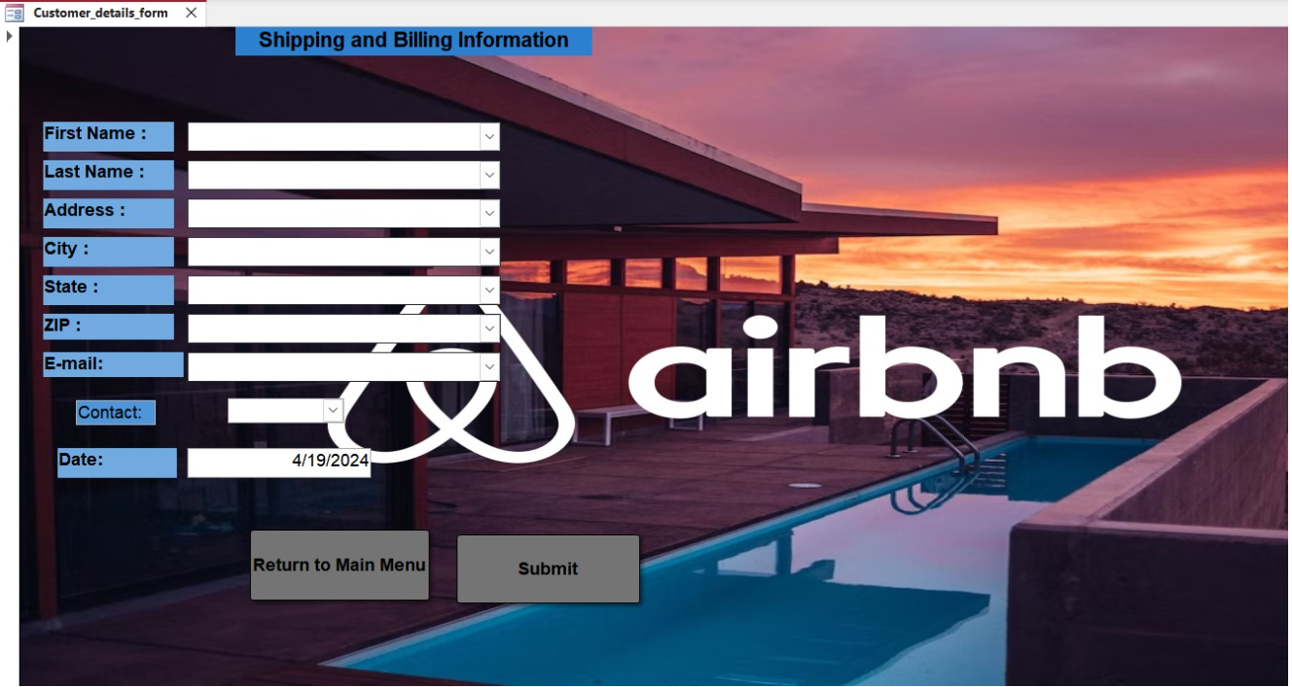
3. Customer Detail Form

Slide 15
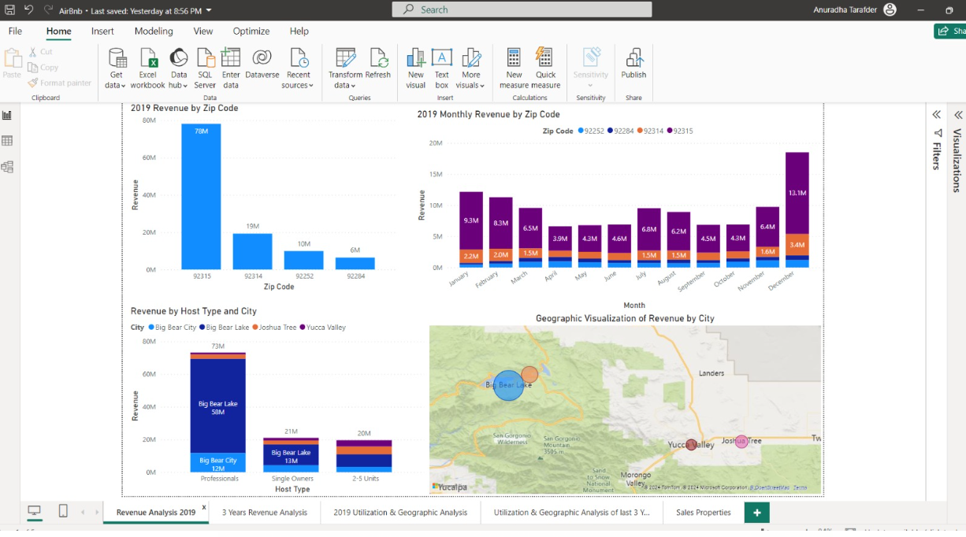
Visualization
1. Revenue Analysis 2019 --

Slide 16
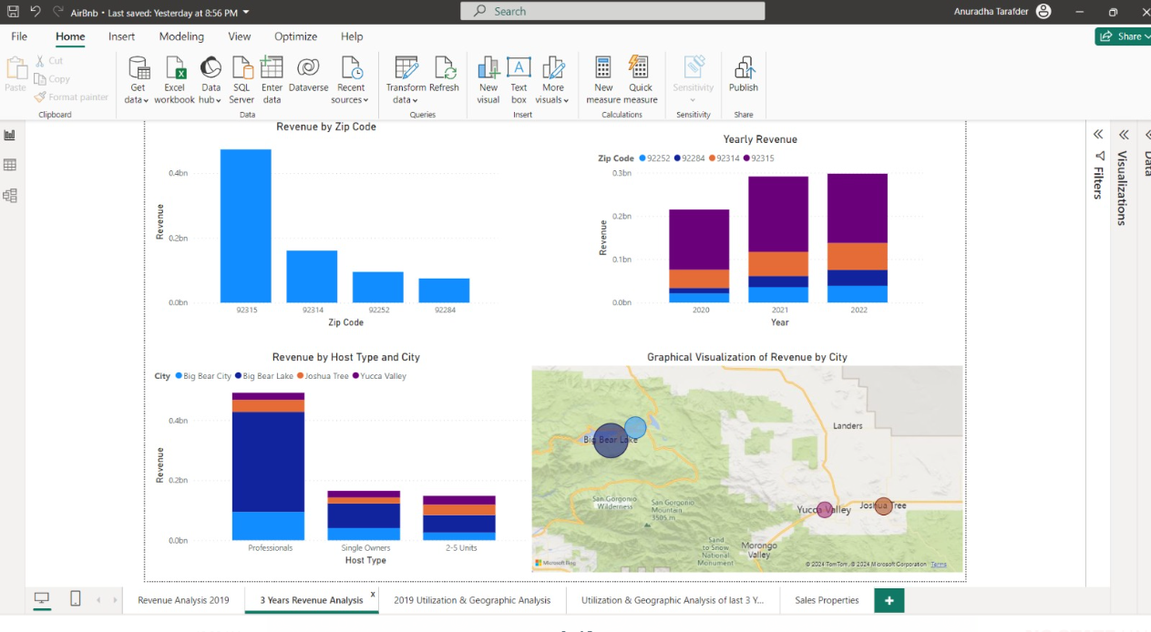
2. 3 Years Revenue Analysis--

Slide 17
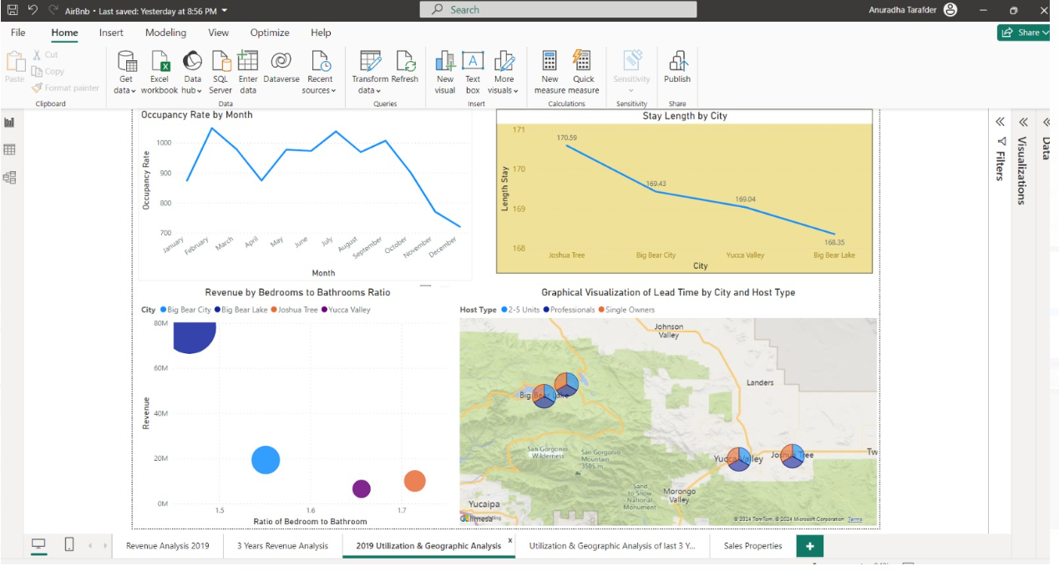
3. 2019 Utilization & Geographical Analysis --

Slide 18
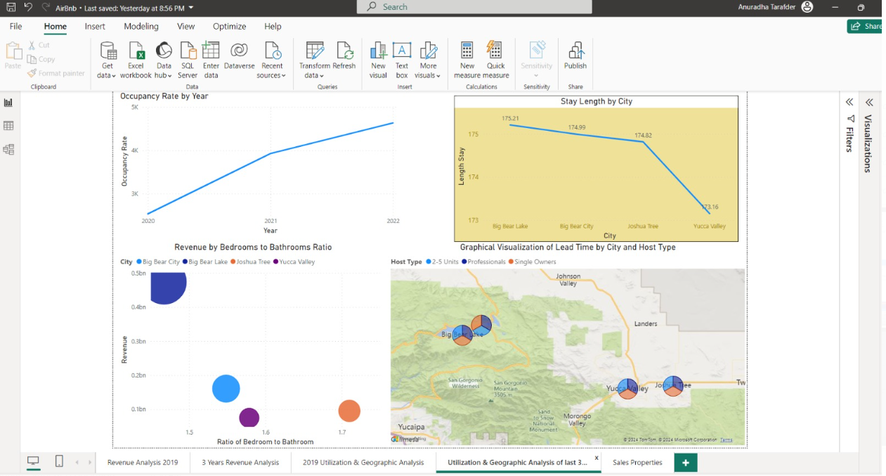
4. Utilization & Geographical Analysis of last 3 years--

Slide 19
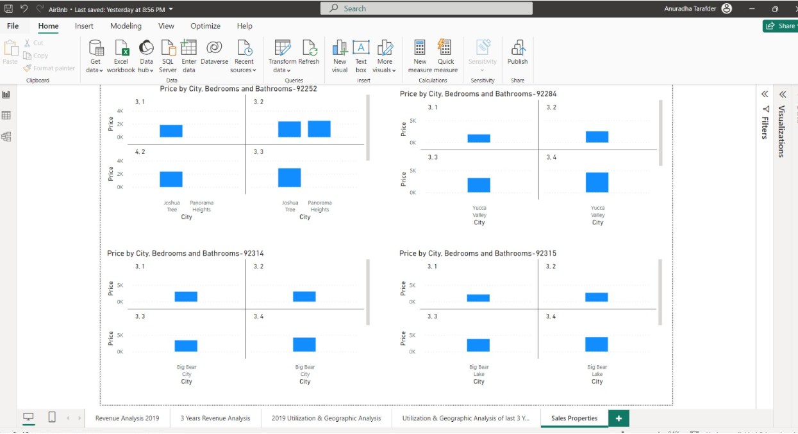
5. Sales Properties --

Slide 20
Thank You

